Slide 1
www.MINEPORTAL.in
ONLINE TEST SERIES FOR
DGMS COAL/METAL FIRST/SECOND CLASS EXAM
GATE MINING EXAM
OVERMAN EXAM TEST
MINING INSPECTOR EXAMS
COAL INDIA MTs & OTHER PSUs EXAMS
FREE STUDY MATERIAL & VIDEO LECTURES
MINING JOBS NOTIFICATIONS
www.mineportal.in Call/Whatsapp-8804777500 www.fb.com/mineportal.in

Slide 2
Global Positioning System (GPS)
The concept of satellite position fixing commenced with the launch of the first Sputnik satellite by the USSR in October 1957.
This was rapidly followed by the development of the Navy Navigation Satellite System (NNSS) by the US Navy referred as the Transit system.
In 1973, the US Department of Defense (DoD) commenced the development of NAVSTAR (Navigation System with Time and Ranging) Global Positioning System (GPS), and the first satellites were launched in 1978.
The accuracies that may be obtained from the system depend on the degree of access available to the user, the sophistication of his/her receiver hardware and data processing software, and degree of mobility during signal reception.
The GPS navigation system relies on satellites that continuously broadcast their own position in space and in this the satellites may be thought of as no more than control stations in space.
Theoretically, a user who has a clock, perfectly synchronized to the GPS time system, is able to observe the time delay of a GPS signal from its own time of transmission at the satellite, to its time of detection at the user’s equipment.
The time delay, multiplied by the mean speed of light, along the path of the transmission from the satellite to the user equipment, will give the range from the satellite at its known position, to the user.
If three such ranges are observed simultaneously, there is sufficient information to compute the user’s position in three-dimensional space, rather in the manner of a three-dimensional trilateration.
The false assumption in all this is that the user’s receiver clock is perfectly synchronized with the satellite clocks.

Slide 3
In practice, although the satellite clocks are almost perfectly synchronized to the GPS time system, the user clock will have an error or offset.
So the user is not directly able to measure the range to a particular satellite, but only the ‘pseudo-range’, i.e. the actual range with an unknown, but instantaneously fixed offset. This is the clock error times the speed of light.
There are four unknown parameters to be solved for in the navigation solution, the three coordinates of user position and the receiver clock offset.
A four parameter solution therefore requires simultaneous observations to four satellites. At least four satellites must be visible at all times, to any observer, wherever he/she may be on or above the surface of the Earth.
Not only must at least four satellites be visible but also they, or the best four if there are more, must be in a good geometric arrangement with respect to the user.
GPS SEGMENTS
The GPS system can be broadly divided into three segments:
(i) The space segment,
(ii) The control segment and
(iii) the user segment.

Slide 4
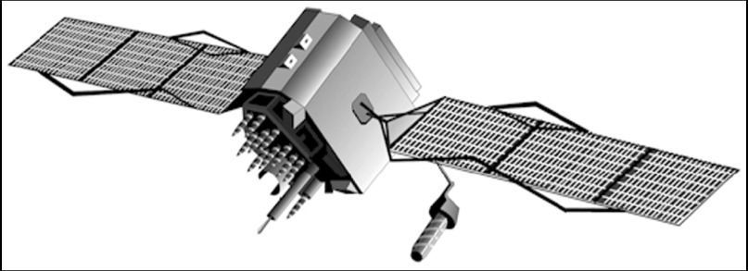
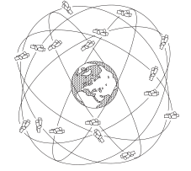
The Space segment
The space segment is composed of satellites. The constellation consists of 27 satellites including spares.
The satellites are in almost circular orbits, at a height of 20,200 km above the Earth or about three times the radius of the Earth and with orbit times of just under 12 hours.
The six orbital planes are equally spaced, and are
inclined at 55° to the equator.
Individual satellites may appear for up to five hours
above the horizon.
The system has been designed so that at least four satellites will always be in view at least 15° above the horizon.
The original planned GPS constellation: 24 satellites in 6 orbital planes, at 55 °inclination and 20, 200 km
altitude with 12-hour orbits (courtesy Leica Geosystems)

Slide 5
The GPS satellites weigh, when in final orbit, approximately 850 kg. The design life of the satellites is 7.5 years but they carry 10 years’ worth of propulsion consumables.
Two sun-seeking single degree of freedom solar arrays, which together cover over 7m² provide the electrical power. Power is retained during eclipse periods by three nickel-cadmium batteries.
Reaction wheels control the orientation and position of the satellite in space. Thermal control louvers, layered insulation and thermostatically controlled heaters control the temperature of this large satellite.
The satellite is built with a rigid body of aluminium boarded honeycomb panels.
The satellite may be ‘navigated’ to a very limited extent in space with small hydrazine jets.
There are two small trim thrusters and 20 even smaller attitude control thrusters.
Antennae transmit the satellite’s signals to the user.
Each satellite carries two rubidium and two caesium atomic clocks to ensure precise timing.
As far as the user is concerned, each GPS satellite broadcasts on two L Band carrier frequencies.
L1 = 1575.42 MHz (10.23 × 154) and L2 = 1227.6 MHz (10.23 × 120).
The carriers are phase modulated to carry two codes, known as the P code or Precise code or PPS (Precise Positioning Service) and the C/A code or Course/Acquisition code or SPS (Standard Positioning Service).

Slide 6
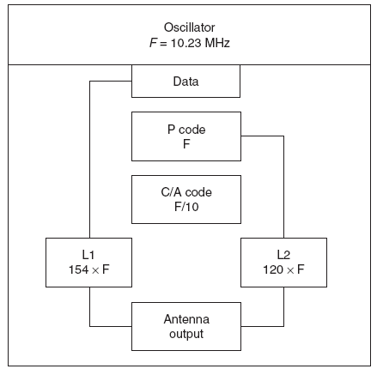
GPS signal generation

Slide 7
The C/A code has a ‘chipping rate’, which is a rate of phase modulation, of 1.023 × 10⁶ bits/sec and the code repeats every millisecond. This means that the sequence that makes up the C/A code is only 1023 bits long. Multiplied by the speed of light, each bit is then 293 m long and the whole code about 300 km.
By contrast, the P code chips at 10.23 × 10⁶ bits/sec and repeats every 267 days although each satellite only uses a seven-day segment of the whole code. The P code is thus about 2.4 × 10¹⁴ bits long.
Without prior knowledge of its structure, the P code will appear as Pseudo Random Noise (PRN). This means that it is relatively easy for the user’s equipment to obtain lock onto the C/A code, since it is short, simple and repeats 1000 times a second.
Without knowledge of the P code, it is impossible in practice to obtain lock because the P code is so long and complex.
This is the key to selective access to the GPS system. Only those users approved by the US DoD will be able to use the P code.
A 50 Hz data stream that contains the following information further modulates each code:
The satellite ephemeris, i.e. its position in space with respect to time
Parameters for computing corrections to the satellite clock
The Hand OverWord (HOW) for time synchronization that allows the user with access to the P code to transfer from the C/A to P code
Information on other satellites of the constellation, including status and ephemerides

Slide 8
The Control Segment
The satellite navigation message, which describes the satellite positions, is uploaded to the satellites by the Operational Control Segment (OCS). The OCS operates as three elements:
• Monitor stations at Ascension Island, Diego Garcia, Kwajalein and Hawaii
• A master control station at Colorado Springs, USA
• An upload station at Vandenberg Air Force Base, USA
The monitor stations are remote, unmanned stations, each with a GPS receiver, a clock, meteorological sensors, data processor and communications. Their functions are to observe the broadcast satellite navigation message and the satellite clock errors and drifts.
The data is automatically gathered and processed by each monitor station and is transmitted to the master control station.
By comparing the data from the various monitor stations the master control station can compute the errors in the current navigation messages and satellite clocks, and so can compute updated navigation messages for future satellite transmission.
These navigation messages are passed to the upload station and are in turn processed for transmission to the satellites by the ground antenna.
The monitor stations then receive the updated navigation messages from the satellites and so the data transmission and processing circle is complete.
The master control station is also connected to the time standard of the US Naval Observatory in Washington, DC.
In this way, satellite time can be synchronized and data relating it to universal time transmitted.
Other data regularly updated are the parameters defining the ionosphere, to facilitate the computation of refraction corrections to the distances measured.

Slide 9
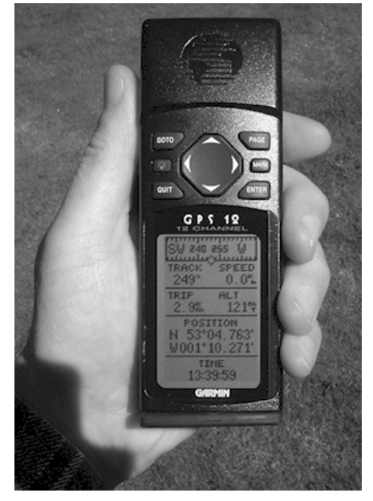
The User Segment
The user segment consists essentially of a portable receiver/processor with power supply and an omnidirectional antenna.
The processor is basically a microcomputer containing all the software for processing the field data.
Handheld GPS Receiver

